Slide 1
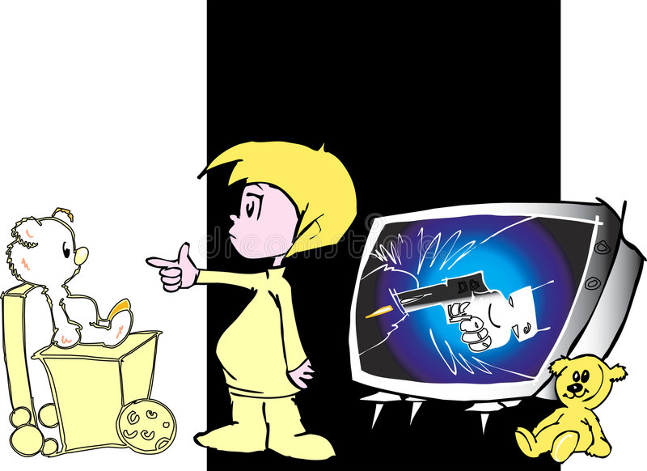
Analysis of an Argument Question
“As violence in movies increases, so do crime rates in our cities.
To combat this problem we must establish a board to censor certain movies, or we must limit admission to persons over 21 years of age. Apparently our legislators are not concerned about this issue since a bill calling for such actions recently failed to receive a majority vote.”

Slide 2
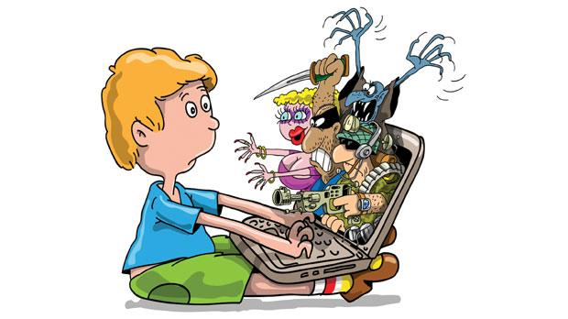

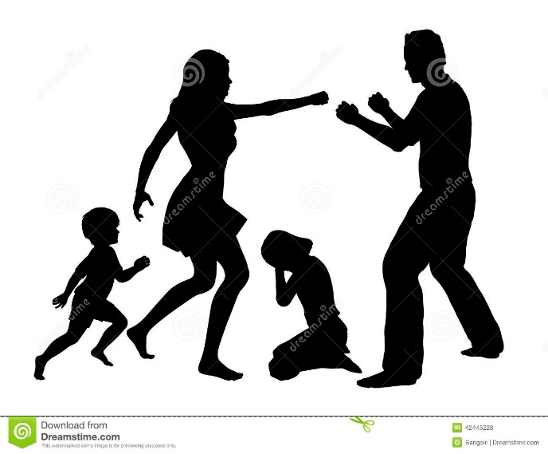
The following questions arise:
1. Which law can forbid watching something what we choose,
in our house?
(such does not exist)
2. Whether minors watch violent content in the presence of parents?
(If they watch, then the parents are also responsible)
3. Do bullies come from harmonious families?
(Maybe their parents are criminals ,
or they live in a family where they watch violence every day)
4. Whether this is just an impression,
or research has been done?

Slide 3
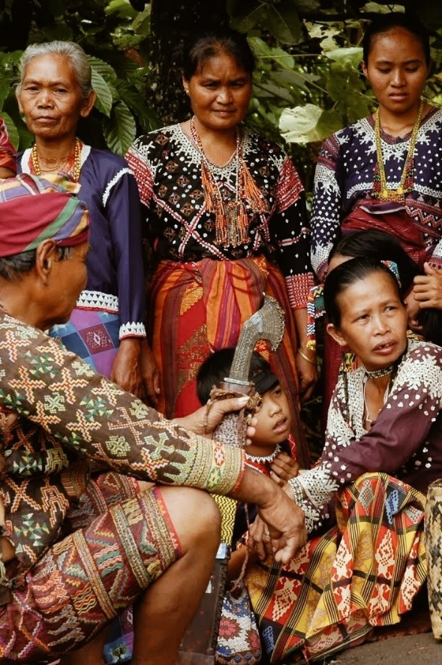

However, my recent interviews with children living in the group of islands that includes Tertia show that these children spend much more time talking about their biological parents than about other adults in the village.
This research of mine proves that Dr. Field's conclusion about Tertian village culture is invalid thus that the observation-centered approach to studying cultures is invalid as well.
The interview-centered method that my team of graduate students is currently using in Tertia will establish a much more accurate understanding of child-rearing traditions there and in other island cultures.“
Analysis of an issue:
“Twenty years ago, Dr. Field, a noted anthropologist,
visited the island of Tertia,
and concluded from his observations that children in Tertia were reared by an entire village rather than by their own biological parents.

Slide 4
The following questions arise:
Why they used different research methods?
(Maybe observing would lead to the same result).
2. Are the questions skillfully adapted to different children's ages?
(If they are not, they can easily lead to the wrong conclusion).
3. Is the same number and age of children included in both studies?
(If not, then the research can not be compared).
4. Why they did not interview the parents of the children?
(Maybe they are the children who grew up with influence of the village,
and now they don't want their children to grow up like that).

